Slide 1




NEXT GEN EMPLOYABILITY PROGRAM
Creating a future-ready workforce
Team Members
College Name
Student Name : Ashika.A
Student ID : au960221243007
Arunachala Collage of Engineering for Women

Slide 2

CAPSTONE PROJECT SHOWCASE
Project Title
Car Rentals Application with Django Framework
Abstract | Problem Statement | Project Overview | Proposed Solution | Technology Used | Modelling & Results | Conclusion

Slide 3
Abstract
The development of a Car Rental web application using the Django framework aims to provide an efficient and user-friendly platform for renting vehicles online.
Through a combination of Django's powerful backend capabilities and modern web design principles, the application facilitates seamless browsing, booking, and management of car rentals.
Key features include a comprehensive search and filtering system, user authentication and authorization, secure payment integration, and administrative tools for managing inventory and reservations.
By leveraging Django's scalability and extensibility, the Car Rental web application offers a reliable solution for both customers seeking rental vehicles and car owners looking to list their vehicles for rent.
Source :

Slide 4
Problem Statement
The traditional process of renting cars often involves time-consuming paperwork, limited availability, and lack of transparency regarding pricing and vehicle options. Additionally, car owners face challenges in efficiently managing their rental inventory and processing bookings. To address these issues, there is a need for a modern, user-friendly Car Rental web application built on the Django framework. This application should streamline the rental process for customers by providing a seamless browsing and booking experience, while also offering car owners efficient tools for managing their inventory and bookings. The goal is to create a platform that enhances the convenience, accessibility, and transparency of car rentals for both customers and car owners.
Source :

Slide 5
Project Overview
Build a user-friendly car rental platform with Django.
Secure user authentication.
List available vehicles with search.
Smooth booking system with payments.
Admin dashboard for inventory management.
Responsive design for all devices.
Thorough testing for quality assurance.
Source :

Slide 6
Proposed Solution
.
Develop a car rental platform with Django for easy access.
Use secure authentication for user safety.
Display available vehicles with easy search options.
Make booking seamless with integrated payments.
Offer an admin dashboard for managing inventory.
Ensure the website works well on any device.
Test thoroughly to ensure quality and reliability.
Source :

Slide 7
Creating a Next Gen Employability program for a car rentals application involves several components:
Django: Python-based web framework for building the application's backend.
User Authentication: Django's built-in authentication system for user registration, login, and account management.
Models: Django's ORM (Object-Relational Mapping) for defining database models, including cars, users, bookings, etc.
Views: Django views for handling HTTP requests and rendering HTML templates.
Templates: HTML templates for the frontend presentation of the application.
Forms: Django forms for data validation and processing, such as user input during registration or booking.
URL Dispatcher: Django's URL dispatcher for mapping URLs to views.
Source :

Slide 8
8. Admin Interface: Django's admin interface for managing application data and users.
9. Static Files: CSS, JavaScript, and other static files for styling and interactivity.
10. Payment Integration: Integration of payment gateways for handling online transactions.
11. Responsive Design: Techniques for ensuring the application's layout adjusts to different screen sizes.
12. Testing: Unit tests and integration tests for ensuring the correctness and reliability of the application.
13. Deployment: Deployment of the application on a web server, often using platforms like Heroku or AWS.
14. External APIs: Integration of external APIs for features like geolocation, vehicle data, or weather information.
Source :

Slide 9


Technology Used
Front-end
Back-end
Source :

Slide 10
Modelling & Results
Database Model : Define models for cars, users, and bookings using Django ORM.
User Authentication : Implement secure authentication for users.
Views & Templates : Create views and templates for browsing cars and managing bookings.
Forms : Develop forms for user input during registration and booking.
URL Dispatcher : Define URL patterns for navigation.
Admin Interface : Utilize Django's admin interface for data management.
Payment Integration : Integrate secure payment gateways.
Responsive Design : Ensure the app works well on all devices.
Testing : Conduct thorough testing for reliability.
Deployment : Deploy the app on a web server.
Source :

Slide 11
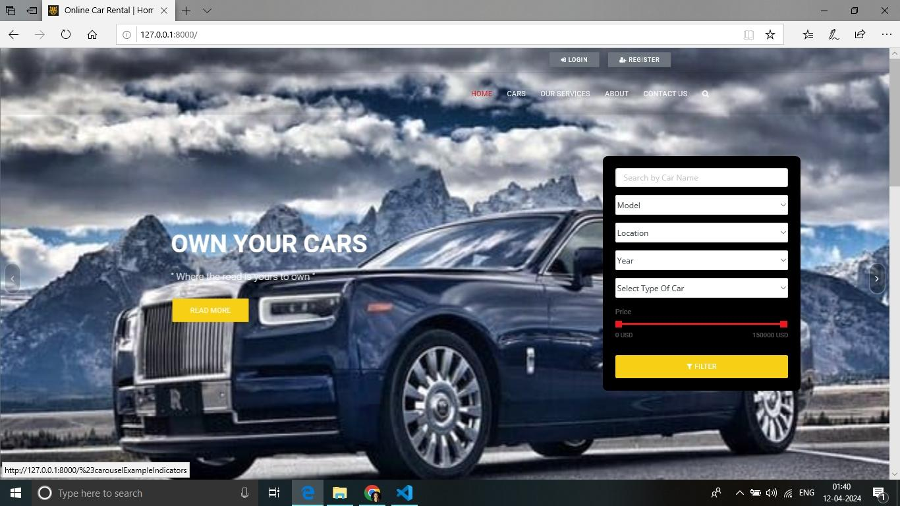
Homepage

Slide 12
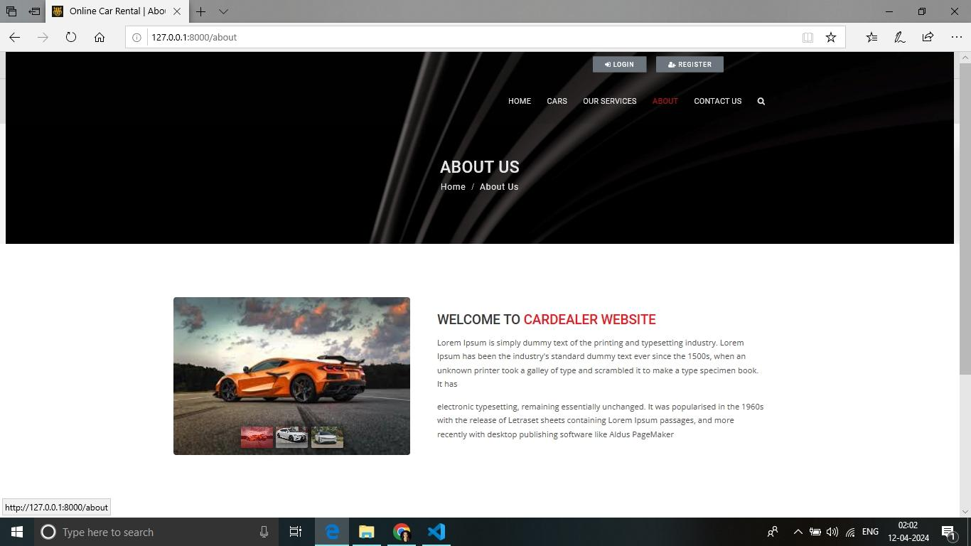
About-Us-Page

Slide 13
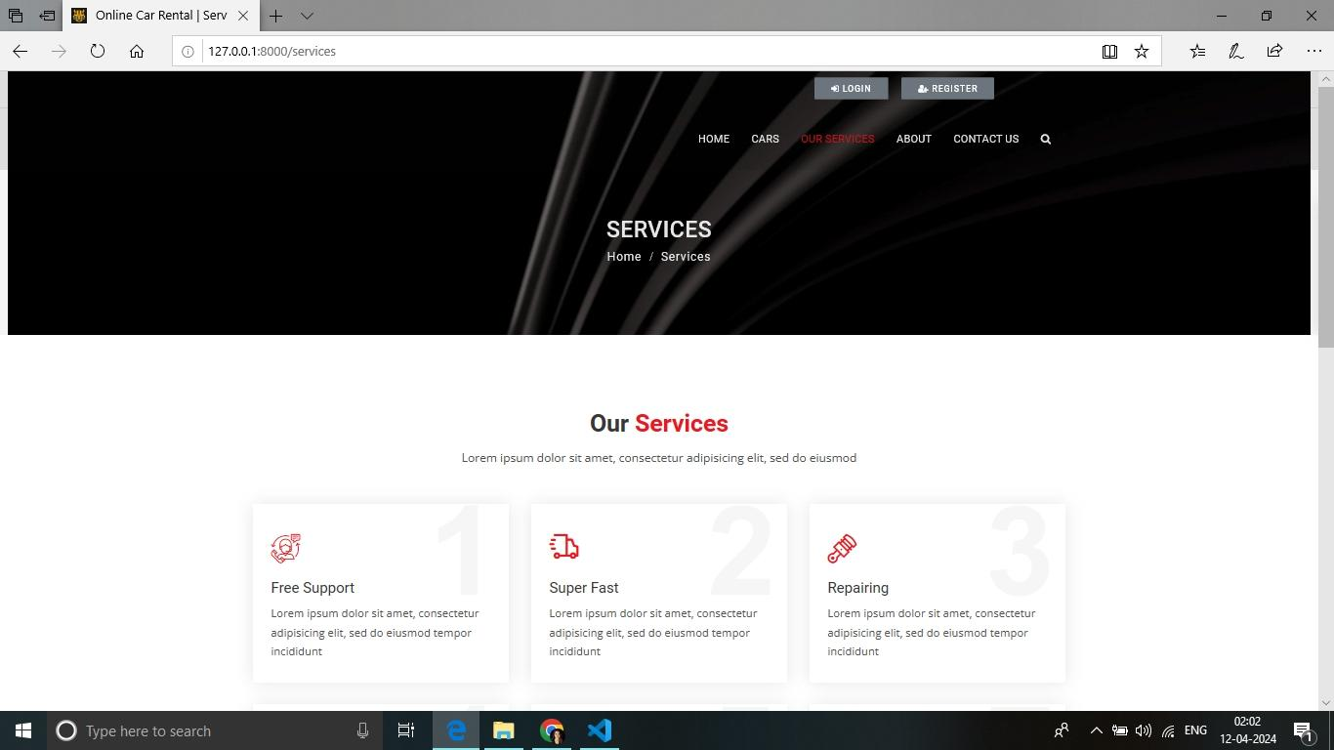
Service-Page

Slide 14
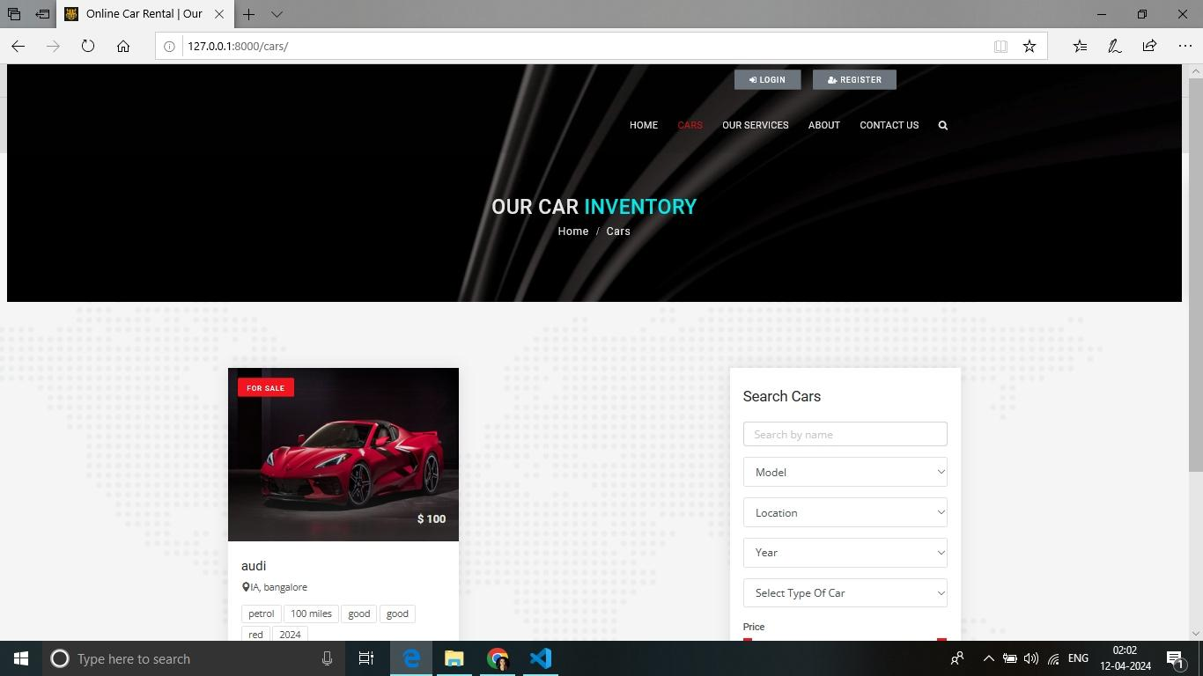
Departments-Page

Slide 15
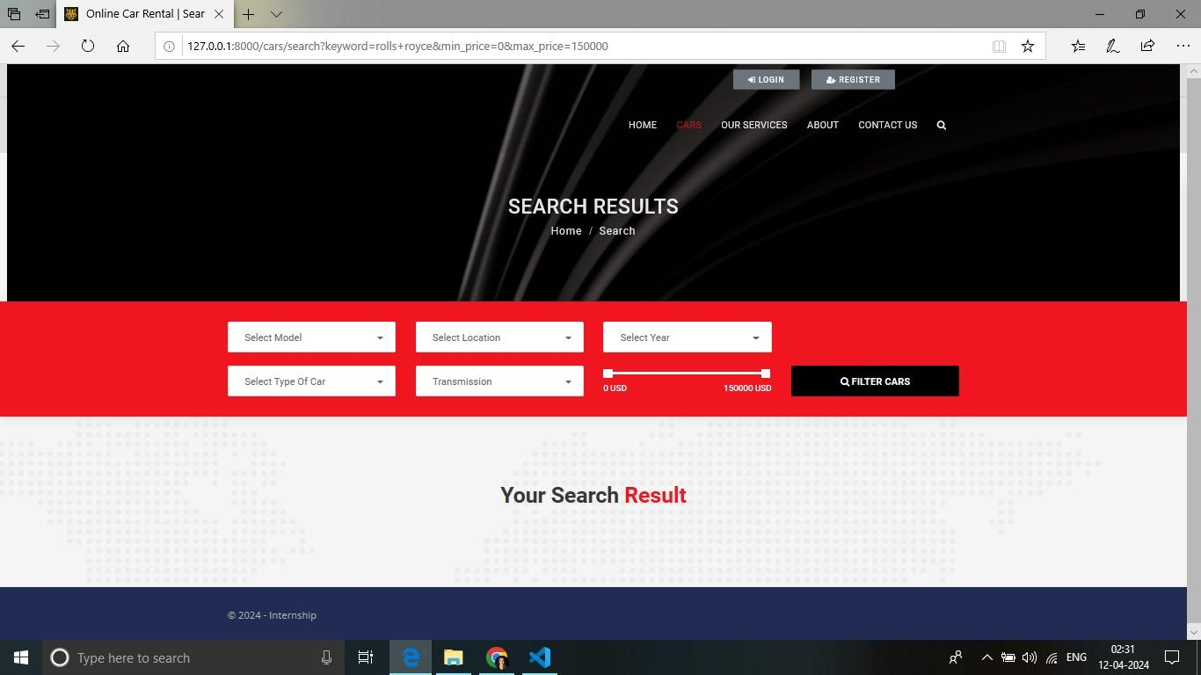
Blog-Page

Slide 16
Future Enhancements:
Implementing a rating and review system for users to provide feedback on their rental experiences.
Integrating a notification system to alert users about booking confirmations, updates, and reminders.
Expanding payment options to include additional gateways and cryptocurrencies for flexibility.
Developing a mobile app version of the web application for enhanced accessibility and user experience.
Incorporating machine learning algorithms for personalized car recommendations based on user preferences and past bookings.
Introducing a loyalty program to reward frequent users with discounts, perks, or exclusive offers.
Enhancing the admin dashboard with advanced analytics and reporting tools for better insight into business performance and user behavior.

Slide 17
Conclusion
By leveraging the Django framework, our car rental web application provides a seamless and secure platform for users to browse, book, and manage car rentals online. With user-friendly features, robust functionality, and thorough testing, the application ensures a positive experience for both customers and car owners. Deploying the app on a web server enables widespread accessibility, contributing to the convenience and efficiency of car rental services in the digital age.
Source :

Slide 18
Thank You!
Notes:
Thank You !!

